Slide 1
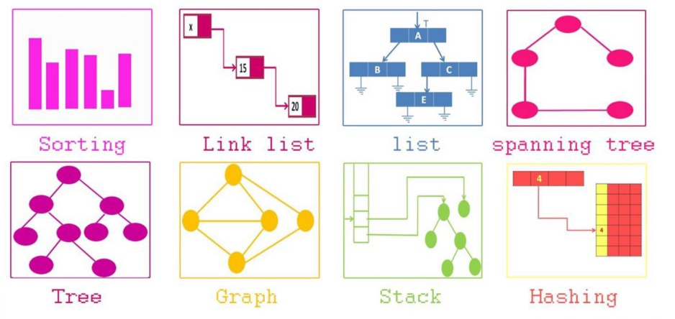

SCSA1304
ADVANCED DATA STRUCTURES
B.E CSE 2020-2024
III SEMESTER
Dr. A. Jesudoss
Associate Professor
Dept. of CSE
jesudossa.cse@sathyabama.ac.in

Slide 2
COURSE OBJECTIVES
➢ To acquire knowledge of organizing the data in non
linear fashion.
➢ To get the idea of balancing the height of trees to
optimize the structure and search time.
➢ To learn the process of establishing the network with
various nodes with minimum cost and finding the
shortest path.
➢ To understand the method of designing the table
data structure and its applications.

Slide 3


Slide 4
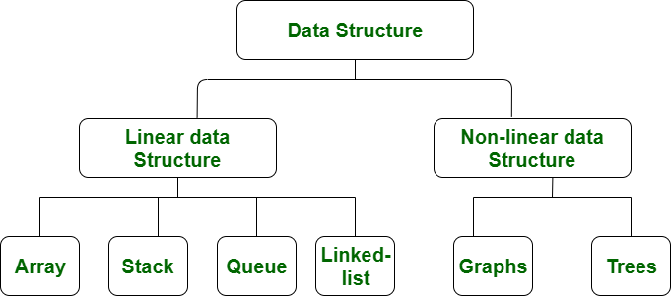
Data structures
A data structure is a collection of data type ‘values’ which are stored and organized in such a way that it allows for efficient access and modification.

Slide 5
Linear Data Structure:
Data structure where data elements are arranged sequentially or linearly where the elements are attached to its previous and next adjacent in what is called a linear data structure.
In linear data structure, single level is involved.
Therefore, we can traverse all the elements in single run only.
Linear data structures are easy to implement because computer memory is arranged in a linear way.
Its examples are array, stack, queue, linked list, etc.

Slide 6
Non-Linear Data Structure:
Data structures where data elements are not arranged sequentially or linearly are called non-linear data structures.
In a non-linear data structure, single level is not involved.
Therefore, we can’t traverse all the elements in single run only.
Non-linear data structures are not easy to implement in comparison to linear data structure.
It utilizes computer memory efficiently in comparison to a linear data structure.
Its examples are trees and graphs.

Slide 7
Trees
Non Linear Data structures
Graphs
Set
Tables

Slide 8
TREE
Director
Non Linear Data Structure
Multiple Level
Collection of entities or nodes linked to gather to stimulate a hierarchy relation
Top – Down Approach
Nodes store information
Unidirectional
Dean
HOD
HOD
FACULTY

Slide 9
Tree - Terminology
In linear data structure data is organized in sequential order and in non-linear data structure data is organized in random order.
A tree is a very popular non-linear data structure used in a wide range of applications. A tree data structure can be defined as follows :
Tree data structure is a collection of data (Node) which is organized in hierarchical structure recursively.
A tree ‘t’ is a finite nonempty set of elements.
There is designated node at the top of the tree known as a root of the tree.
The remaining elements, if any, are partitioned into trees, which are called the subtrees of ‘t’.
In tree data structure, every individual element is called as Node. Node in a tree data structure stores the actual data of that particular element and link to next element in Hierarchical structure. In a tree data structure, if we have N number of nodes then we can have a maximum of
N-1 number of links.

Slide 10
TREES
Trees
Tree and Binary Trees terminology
Properties of Binary trees
Implementation using Array and Linked list
Binary tree
ADT representations
Recursive and Non Recursive Traversals
Binary Search tree
Insertion
Deletion

Slide 11

Top Down Approach
Director
Dean
HOD
HOD
FACULTY

Slide 12
Terminology of Tree
Director
A
Root: No Parent, Top Most Element or First Element in Hierarchy
Node: Store Information
Parent Node: Immediate predecessor of any node
Child Node: Immediate Successor of node
Branch: Relationship between parent and child. Also called as Edges
Leaf Node/ External Node: No children
B
Dean
C
D
E
F
G
HOD
HOD
H
I
J
K
L
M
N
O
FACULTY

Slide 13
Terminology of Tree
Internal Node: Children (Non Leaf Node – other than leaf nodes)
Path: Sequent of consecutive edges from source to destination
Ancestor: Any predecessor node on the path from root to that node
Descendant: Any Successor node on the path from that node to leaf node
Subtree: Subset of tree that is itself a tree (Descendant)
Sibling: All children of same parent
Cousins: Children's of different parent
Degree: No. of Children of that node (Tree-Max)
Director
A
B
Dean
C
D
E
F
G
HOD
HOD
H
I
J
K
L
M
N
O
FACULTY

Slide 14
Terminology of Tree
Depth of Node: Length of path from root to that node
Height of Node: No. of Edges in the longest path from that node to leaf node
Level of Node: Distance from root to the given node (No. of Edges)
Level = Depth ->node and edges
N Nodes means N-1 Edges
Director
Level 0
A
Level 1
B
C
Dean
Level 2
D
E
F
G
HOD
HOD
Level 3
H
M
N
O
I
J
K
L
File system, Quick Search, Organize (Binary tree, Heap tree)
FACULTY

Slide 15
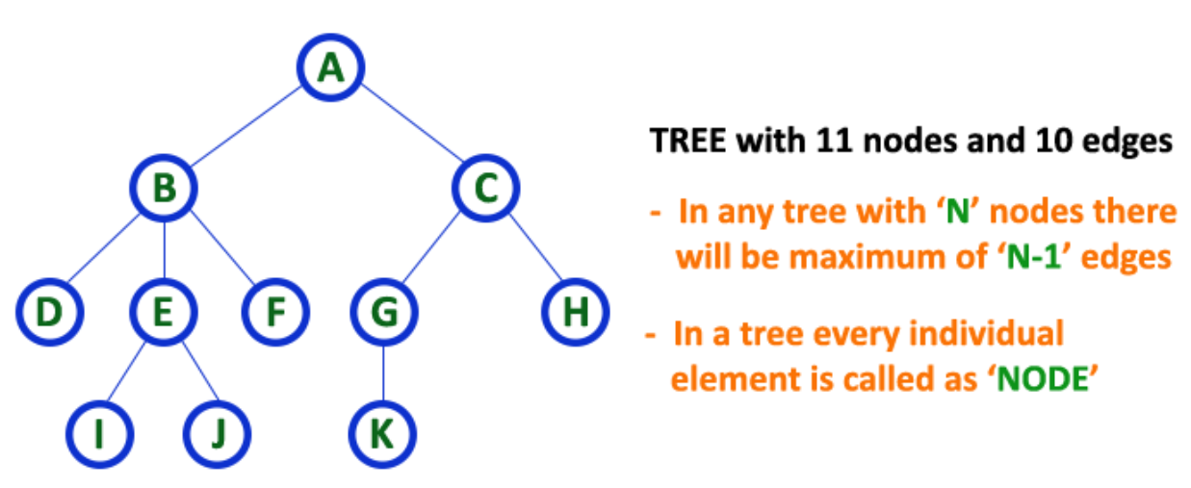
Terminology of Tree
Notes:
Root
Children
Leaf Node
Parent Node
Ancestors
Climbing
Descending

Slide 16
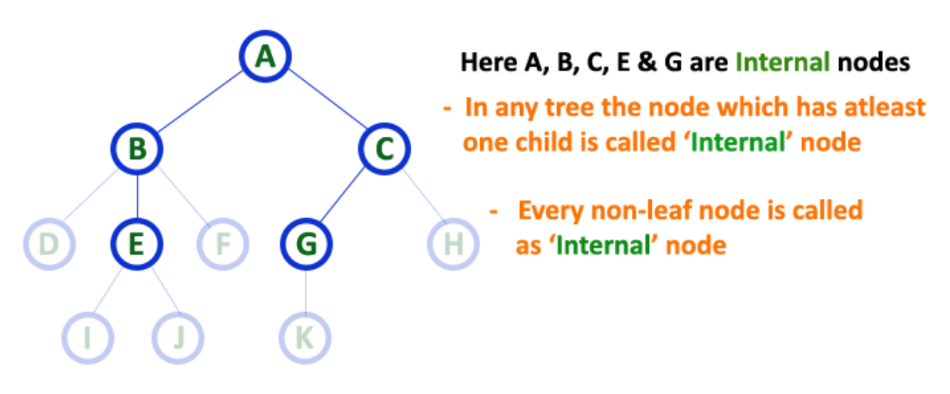
Terminology of Tree
Notes:
Internal Nodes
In a tree data structure, the node which has atleast one child is called as INTERNAL Node.
In simple words, an internal node is a node with atleast one child. In a tree data structure, nodes other than leaf nodes are called as Internal Nodes.
The root node is also said to be Internal Node if the tree has more than one node. Internal nodes are also called as 'Non-Terminal' nodes.

Slide 17
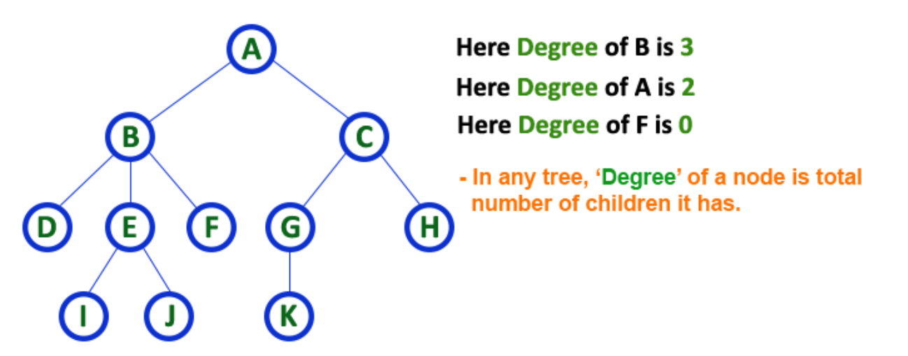
Terminology of Tree
Notes:
In a tree data structure, the total number of children of a node is called as DEGREE of that Node. In simple words,
the Degree of a node is total number of children it has. The highest degree of a node among all the nodes in a tree is called as 'Degree of Tree'

Slide 18
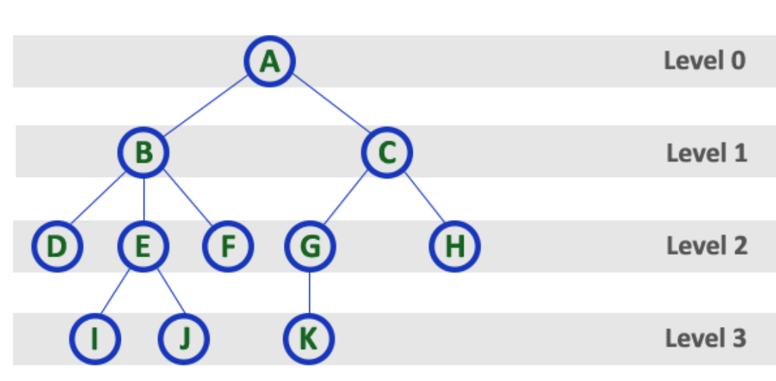
Terminology of Tree
Notes:
In a tree data structure, the root node is said to be at Level 0 and the children of root node are at Level 1 and
the children of the nodes which are at Level 1 will be at Level 2 and so on...
In simple words, in a tree each step from top to bottom is called as a Level and the Level count starts with '0' and incremented by one at each level (Step).

Slide 19
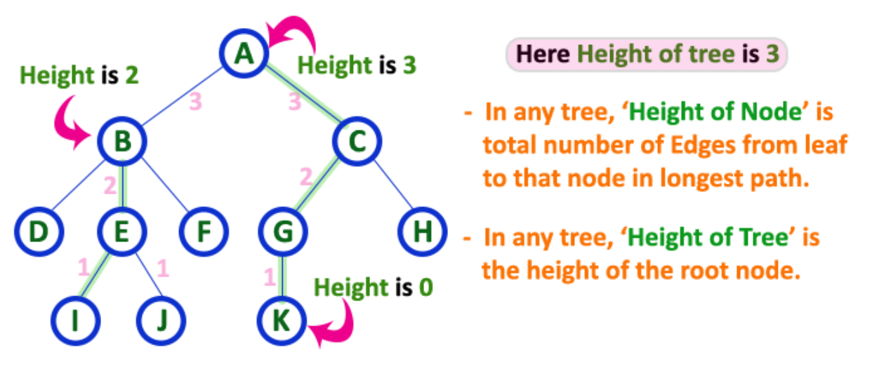
Terminology of Tree
Notes:
In a tree data structure, the total number of edges from leaf node to a particular node in the longest path is called as HEIGHT of that Node.
In a tree, height of the root node is said to be height of the tree. In a tree, height of all leaf nodes is '0'.

Slide 20
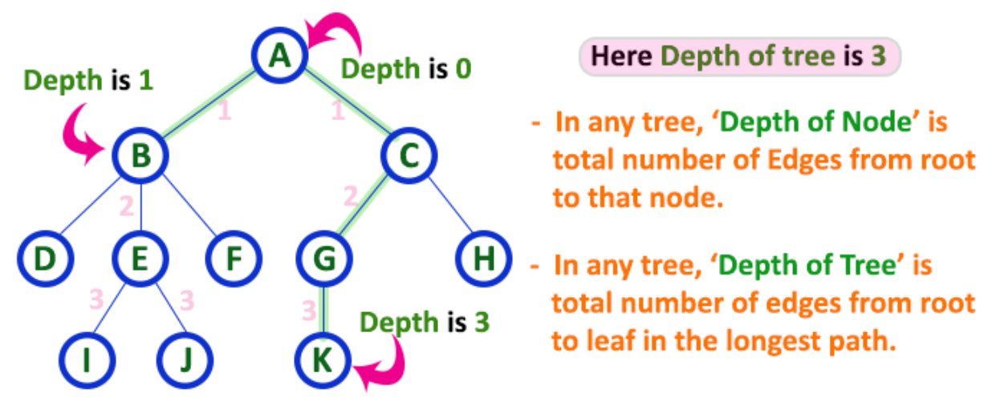
Terminology of Tree
Notes:
In a tree data structure, the total number of egdes from root node to a particular node is called as DEPTH of that Node.
In a tree, the total number of edges from root node to a leaf node in the longest path is said to be Depth of the tree.
In simple words, the highest depth of any leaf node in a tree is said to be depth of that tree. In a tree, depth of the root node is '0'.

Slide 21
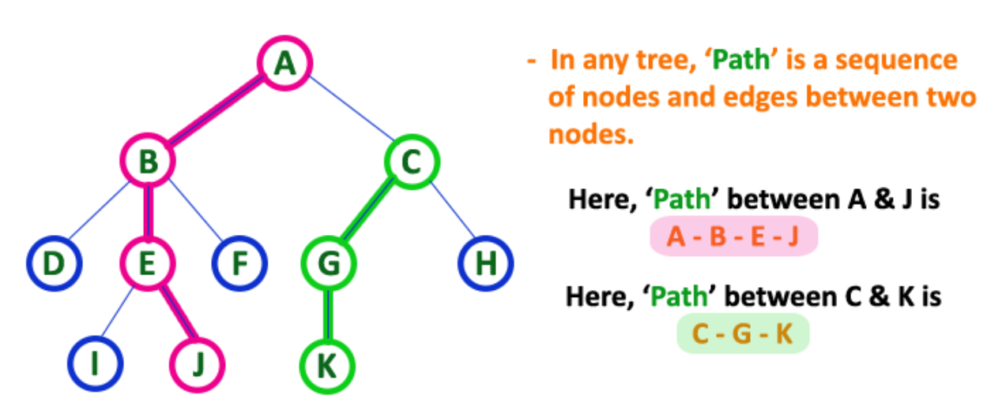
Terminology of Tree
Notes:
In a tree data structure, the sequence of Nodes and Edges from one node to another node is called as PATH between that two Nodes.
Length of a Path is total number of nodes in that path. In below example the path A - B - E - J has length 4.

Slide 22
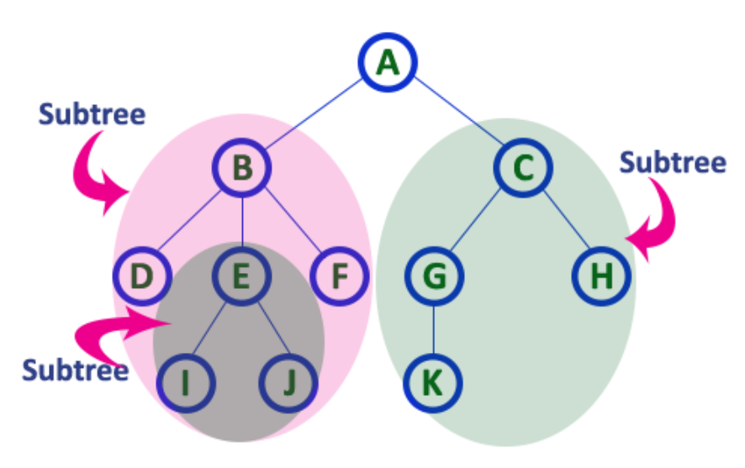
Terminology of Tree
Notes:
In a tree data structure, each child from a node forms a subtree recursively. Every child node will form a subtree on its parent node.

Slide 23
BINARY TREE
Finite collection of elements.
A nonempty binary tree has a root element.
The remaining elements are partitioned into two binary trees.
These are called the left and right subtrees of the binary tree.

Slide 24
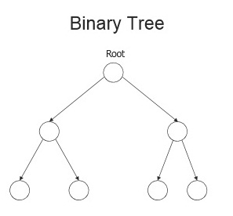
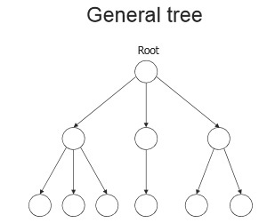
BINARY TREE | TREE
No node in a binary tree may have a degree more than 2 (max. 2 child) | No limit on the degree of a node in a tree (any no. of children)
A binary tree may be empty | A tree cannot be empty
The subtrees are ordered | The subtrees are not ordered
Left & Right Binary Trees | Zero subtree or many trees

Slide 25
BINARY TREE Vs TREE
Representations of Tree :
Array Representation
Linked List Representation

Slide 26

Array Representation
If a complete binary tree with n nodes is represented sequentially, then for any node with index i, 1 ≤ i ≤ n,
PARENT(i) is at | i / 2 | if i > 1.
If i = 1, i is at the root and has no parent.
LEFTCHILD(i) is at 2i if 2i ≤ n,
if 2i > n, i has no left child
RIGHTCHILD(i) is at 2i + 1 if 2i +1 ≤ n,
if 2i +1 > n, i has no right child

Slide 27
Example 1
1
2
3
4
5
6
7
8
9
10
11
12
13
14
15

Slide 28
Example 1
index | tree
[0] | --
[1] | A
[2] | B
[3] | C
[4] | D
[5] | E
[6] | F
[7] | G
[8] | H
[9] | I
[10] | J
[11] | K
[12] | L
[13] | M
[14] | N
[15] | O
A
B
C
D
E
F
G
H
I
J
K
L
M
N
O

Slide 29
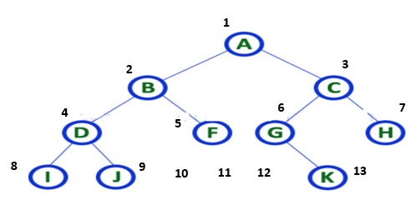

Representation of Tree – Arrays
11
12
13
1 | 2 | 3 | 4 | 5 | 6 | 7 | 8 | 9 | 10 | 11 | 12 | 13 | 14 | 15
Notes:
In array representation of a binary tree, we use one-dimensional array (1-D Array) to represent a binary tree. Consider the above example of a binary tree and it is represented as follows...
To represent a binary tree of depth 'n' using array representation, we need one dimensional array with a maximum size of 2n + 1.

Slide 30
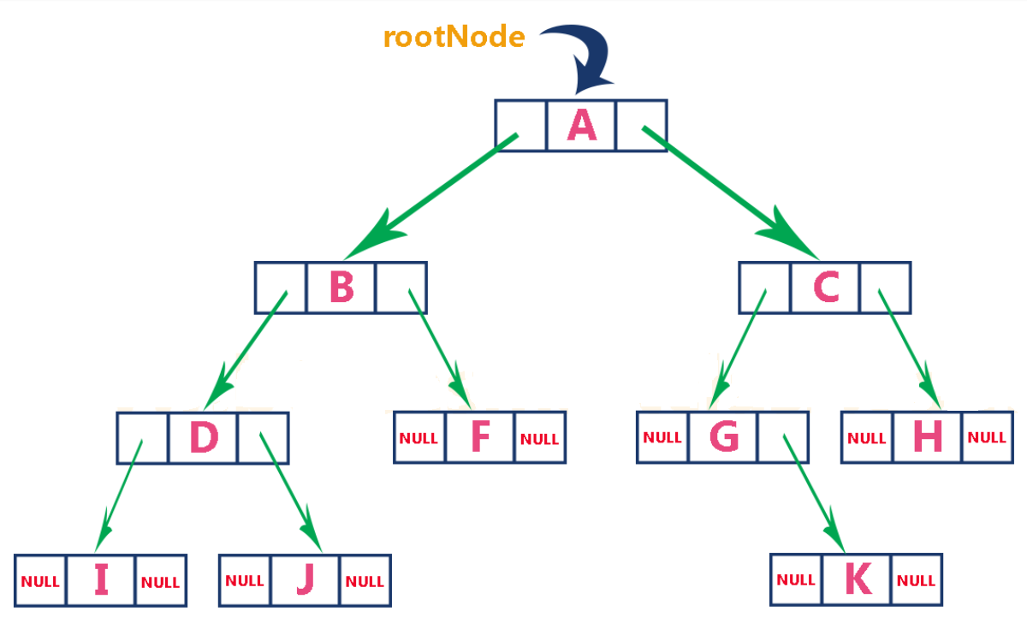
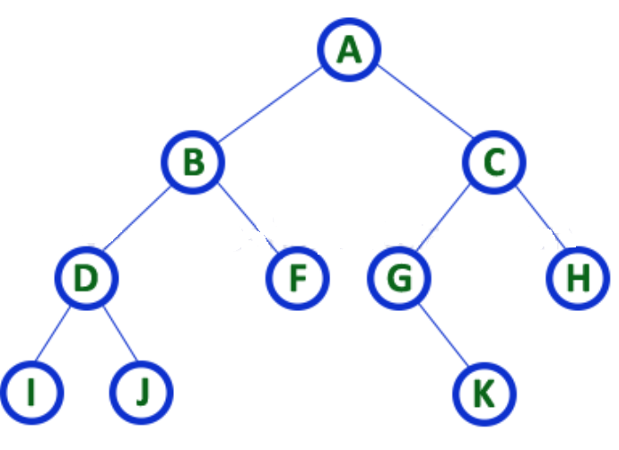

Representation of Tree – Linked List
Notes:
We use a double linked list to represent a binary tree. In a double linked list, every node consists of three fields. First field for storing left child address, second for storing actual data and third for storing right child address. In this linked list representation, a node has the following structure...

Slide 31
BINARY TREE
A
A
B
C
B
STRICTLY BINARY TREE
It is a tree in each node having at most of two children (0,1,2)
Representation:
SKEWED BINARY TREE
A
A
A(L) | Node | A(R)
B
D
X | Node | A(R)
A
A
Ex. 1:
X
X
A(Node B) | A | A(Node C)
B
C
D
B
C
D
A full binary tree (Strict binary tree/ proper bt) is one in which every internal node has zero two children.
Where X indicates not a binary tree

Slide 32
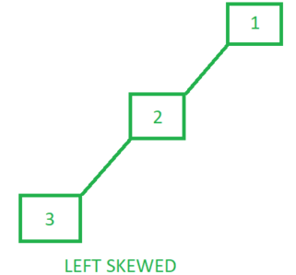
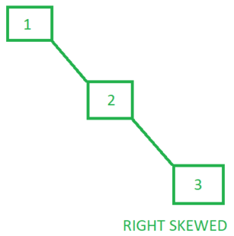
SKEWED BINARY TREE
A skewed binary tree is a type of binary tree in which all the nodes have only either one child or no child.
Types of Skewed Binary trees
There are 2 special types of skewed tree:
Left Skewed Binary Tree:
These are those skewed binary trees in which all the nodes are having a left child or no child at all. It is a left side dominated tree. All the right children remain as null.
Left Skewed Binary Tree:
These are those skewed binary trees in which all the nodes are having a right child or no child at all. It is a right side dominated tree. All the left children remain as null.

Slide 33
BINARY TREES
Ex. 2:
A
A
A(Node B) | Node A | -
B
STRICTLY BINARY TREE
C
B
Ex. 3:
A(Node B) | Node A | -
SKEWED BINARY TREE
A
A
A(Node D) | Node B
B
D

Slide 34
BINARY TREES
Benefits of Binary Trees
An ideal way to store data in a hierarchical way.
Reflect structural relationships that exist in the given data set
Make insertion and deletion faster than list and Array pattern.
A flexible way of holding and moving data
Used to store as many nodes as possible
Faster than linked lists and slower than arrays when we try to accessing elements

Slide 35
BINARY TREES
Benefits of Binary Trees
7. The search operation in a binary tree is faster as compared to other trees
8. Only two traversals are enough to provide the elements in sorted order
9. It is easy to pick up the maximum and minimum elements
10. Graph traversal also uses binary trees
11. Converting different postfix and prefix expressions are possible using binary trees

Slide 36
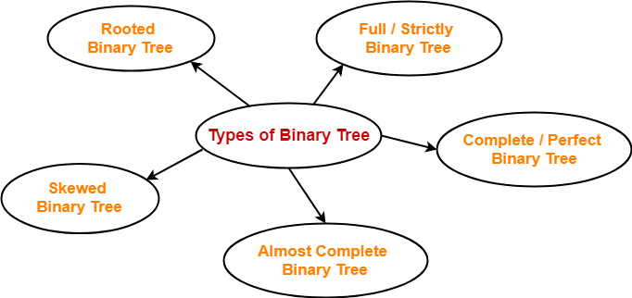
BINARY TREES - TYPES

Slide 37
Special Binary Tree
Skewed Tree
Left Skewed
Right Skewed
Complete Binary Tree – all levels complete, except last with left nodes
Full Binary Tree – complete at all levels (with 2 nodes)
Perfect Binary tree – all leaves at the same level
Rooted Binary Tree – only root is allowed to have degree 2 others <2

Slide 38
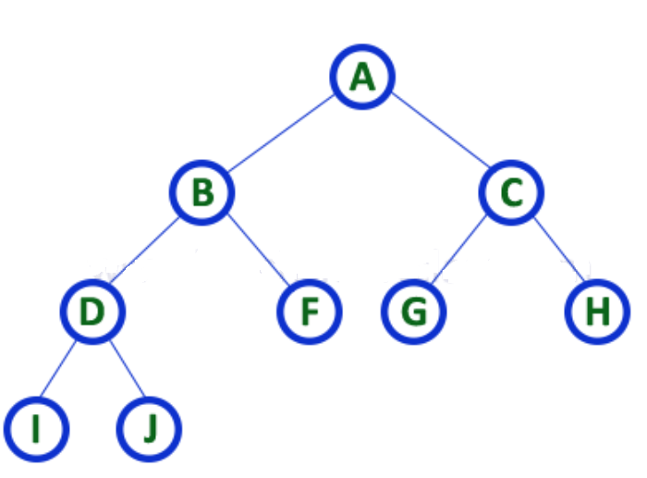
STRICTLY BINARY TREES
Strictly binary tree is also called as Full Binary Tree or Proper Binary Tree or 2-Tree
A binary tree in which every node has either two or zero number of children is called Strictly Binary Tree
Notes:
In a binary tree, every node can have a maximum of two children. But in strictly binary tree, every node should have exactly two children or none. That means every internal node must have exactly two children.
Strictly binary tree is also called as Full Binary Tree or Proper Binary Tree or 2-Tree
A strictly Binary Tree can be defined as follows...
A binary tree in which every node has either two or zero number of children is called Strictly Binary Tree

Slide 39
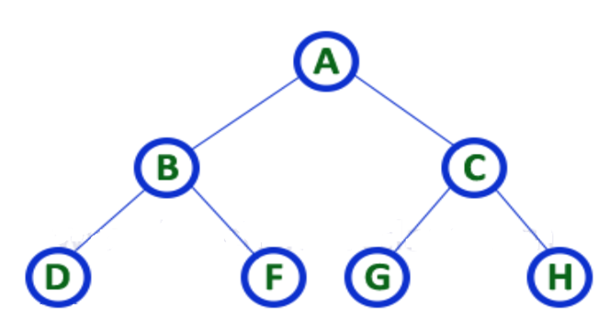
PERFECT BINARY TREES
Perfect binary trees are binary trees whose leaves are present at the same level and whose internal nodes carry two children.
Notes:
Perfect binary trees: Perfect binary trees are binary trees whose leaves are present at the same level and whose internal nodes carry two children.
A common example of a perfect binary tree is an ancestral family tree.

Slide 40
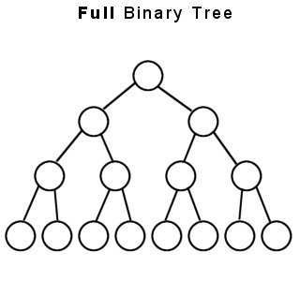
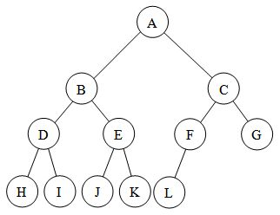
COMPLETE BINARY TREES
Complete Binary Tree
A binary tree in which every internal node has exactly two children and all leaf nodes are at same level is called Complete Binary Tree.
A complete binary tree is a binary tree in which every level, except possibly the last, is completely filled, and all nodes are as far left as possible.
Notes:
In a binary tree, every node can have a maximum of two children. But in strictly binary tree, every node should have exactly two children or
none and in complete binary tree all the nodes must have exactly two children and at every level of complete binary tree there must be
2^{level} number of nodes. For example at level 2 there must be 2² = 4 nodes and at level 3 there must be 2³ = 8 nodes.
A binary tree in which every internal node has exactly two children and all leaf nodes are at same level is called Complete Binary Tree.
Complete binary tree is also called as Perfect Binary Tree

Slide 41
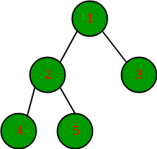
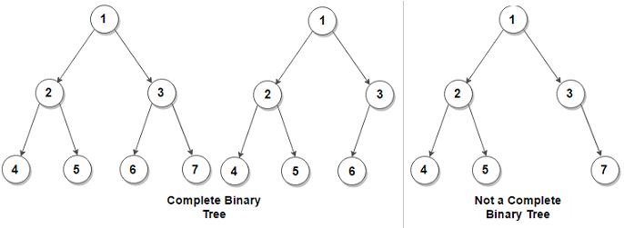
Complete Binary Tree (All nodes till the second last nodes are filled and all leaves are to the left side)
except possibly the last
except possibly the last
Because it is on right side

Slide 42
LEFT SKEWED TREE
A
B
C
D

Slide 43
RIGHT SKEWED TREE
A
B
C
D
E

Slide 44
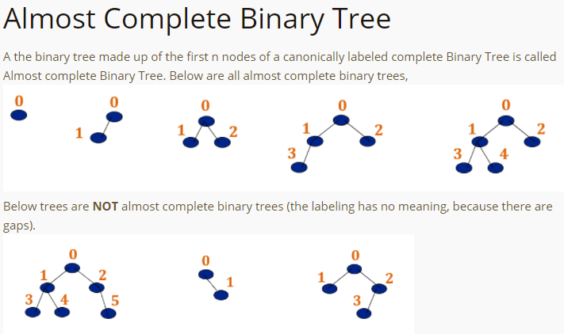

Slide 45
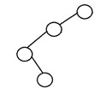
DEGENERATE BINARY TREE
A binary tree is said to be a degenerate binary tree or pathological binary tree if every internal node has only a single child.
Such trees are similar to a linked list performance-wise.
V
Here is an example of a degenerate binary tree:

Slide 46
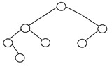
BALANCED BINARY TREE
A binary tree is said to be ‘balanced’ if the tree height is O(logN), where ‘N’ is the number of nodes.
In a balanced binary tree, the height of the left and the right subtrees of each node should vary by at most one.
An AVL Tree and a Red-Black Tree are some common examples of data structure that can generate a balanced binary search tree.
Here is an example of a balanced binary tree:

Slide 47
PROPERTIES OF BINARY TREE
Maximum No. of nodes possible at any level is N = [2 power (i)]
i.e (2^i)
Level 0 = 2^0 =1
Level 1 = 2^1 =2
Level 2 = 2 ^ 2 = 4
Level 3 = 2 ^ 3 = 8
Level 4 = 2 ^ 4 = 16
Note: It is not maximum number of nodes possible in Binary Tree. It is maximum no. of nodes at particular level only.

Slide 48
The maximum number of nodes at level ‘l’ of a binary tree is 2^{l}.
Here level is the number of nodes on the path from the root to the node (including root and node). Level of the root is 0.
For root, l = 0, number of nodes = 2⁰ = 1
Assume that the maximum number of nodes on level ‘l’ is 2^{l}
Since in Binary tree every node has at most 2 children, next level would have twice nodes, i.e. 2 * 2^{l}

Slide 49
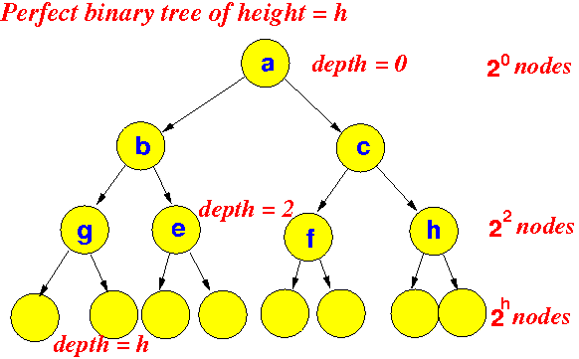

Slide 50
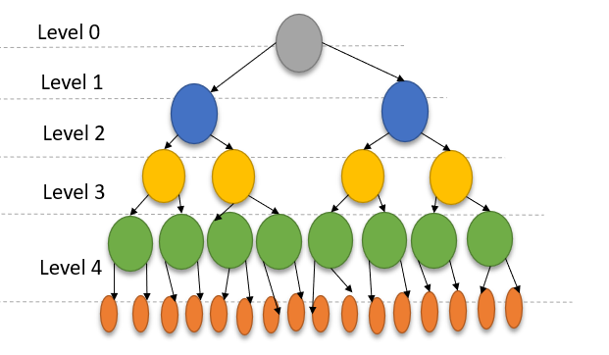
PROPERTIES OF BINARY TREE
2. Maximum No. of Nodes at height h is N = ((2^(h+1)) -1)
= 0 + 1 + 2 + 3 + 4
= 2^0 + 2^1 + 2^2 + 2^3 + 2^4
= 1 + 2 + 4 + 8 + 16 (Geometric Progression Series)
Eg. HEIGHT = LEVEL
WHERE H = 4
(2^(4 + 1)) – 1 = 31 NODES
Remember - Property 1:Maximum No. of nodes possible at any level is N = [2 power (i)] i.e (2^i)

Slide 51
PROPERTIES OF BINARY TREE
= 0 + 1 + 2 + 3 + 4
= 2^0 + 2^1 + 2^2 + 2^3 + 2^4
= 1 + 2 + 4 + 8 + 16 (GP SERIES)
EX. HEIGHT = LEVEL
WHERE H = 4
(2^(4 + 1)) – 1 = 31 NODES

Slide 52
PROPERTIES OF BINARY TREE
The Maximum number of nodes in a binary tree of height ‘h’ is 2^{h} – 1. Here the height of a tree is the maximum number of nodes on the root to leaf path.
Height of a tree with a single node is considered as 1.
This result can be derived from point 2 above. A tree has maximum nodes if all levels have maximum nodes.
So maximum number of nodes in a binary tree of height h is 1 + 2 + 4 + .. + 2^{h}. This is a simple geometric series with h terms and sum of this series is 2^{h}– 1.
In some books, the height of the root is considered as 0. In this convention, the above formula becomes 2^{h+1} – 1

Slide 53
PROPERTIES OF BINARY TREE
3. MINIMUM NO. OF NODES AT HEIGHT H IS N = H + 1
Height = Level
LEVEL 0
Ex. 1 : Level = 0 then h = 0
Ans : 1
Ex. 2 : Level = 1 then h =1
Ans: 2
Ex. 3 : Level = 2 then h = 2
Ans: 3
Ex. 4 : Level = 3 then h = 3
Ans: 4
LEVEL 1
LEVEL 0
LEVEL 1
LEVEL 2
LEVEL 3

Slide 54
PROPERTIES OF BINARY TREE
4. Maximum Height of N nodes:
[ (Min. No. of Nodes in Height H) (N = h + 1) ]is H = N – 1
Level 0
Ex., N = 5 then H = 4
Level 1
Don’t Confuse with Max. No. of Nodes
Level 2
Level 3
Level 4

Slide 55
PROPERTIES OF BINARY TREE
5. Number of edges possible at n elements : E = N - 1
Ex., N = 5 Then E = 4
1
2
3
4

Slide 56
PROPERTIES OF BINARY TREE
6. Number of Internal Nodes (Children) in
Complete Binary Tree is N / 2
1
2
Nodes = 5
So 5/2=2.5
Round to 2
Internal Nodes = 2
3
4
Notes:
N/2
4/2
2 Internal nodes

Slide 57
PROPERTIES OF BINARY TREE
7. Number of Leaf Node (No children) in a perfect Binary
tree is L = (N + 1) / 2
1
2
N = 5
L = (5 + 1) / 2
L = 3
3
4
Notes:
A binary tree with ‘L’ leaves has at least log2L+1log2⁡L+1 number of levels
The maximum number of nodes at level ‘l’ will be 2l−12l−1 . Here level is the number of nodes on path from root to the node, including the root itself. We are considering the level of root is 1.
Maximum number of nodes present in binary tree of height h is 2h−12h−1 . Here height is the max number of nodes on root to leaf path. Here we are considering height of a tree with one node is 1.
In a binary tree with n nodes, minimum possible height or minimum number of levels arelog2⟮n+1⟯log2⁡⟮n+1⟯ . If we consider that the height of leaf node is considered as 0, then the formula will be log2⟮n+1⟯−1log2⁡⟮n+1⟯−1
A binary tree with ‘L’ leaves has at least log2L+1log2⁡L+1 number of levels
If a binary tree has 0 or 2 children, then number of leaf nodes are always one more than nodes with two children.

Slide 58
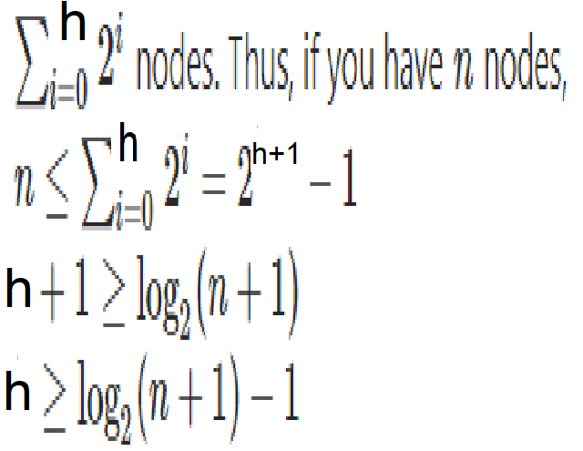
PROPERTIES OF BINARY TREE
8. Minimum Height of N nodes:
[ (Max. No. of Nodes in Height H) is N = ((2^(h+1)) -1) ]
THEN H= ?????
Level 0
Level 1
Level 2
Level 3
Level 4
Notes:
In a Binary Tree with N nodes, minimum possible height or minimum number of levels is ?
Log₂(N+1) ? This can be directly derived from point 2 above. If we consider the convention where height of a leaf node is considered as 0, then above formula for minimum possible height becomes ? Log₂(N+1) ? – 1
In a binary tree with n nodes, minimum possible height or minimum number of levels arelog2⟮n+1⟯log2⁡⟮n+1⟯ . If we consider that the height of leaf node is considered as 0, then the formula will be log2⟮n+1⟯−1

Slide 59
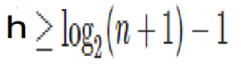
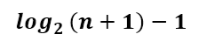
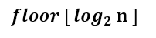
PROPERTIES OF BINARY TREE
Level 0
Level 1
If no of nodes =5
Log (5+1) to base 2 =2.58 LOG(6)/LOG(2)
So take upper bound =3
So height = 3-1
Therefore =2
Level 2
Height of a perfect binary tree having ’n’ nodes is -
Height of a complete binary tree having ’n’ nodes is -

Slide 60
What is Logarithm?
A logarithm is the power to which a number must be raised in order to get some other number.
For example, the base ten logarithm of 100 is 2, because ten raised to the power of two is 100: log 100 = 2.

Slide 61
BINARY TREE - ADT
Class BinaryTree
{
Objects
A finite set of nodes either empty or consisting of a root
node, left BinaryTree and right BinaryTree
Methods
BinaryTree() // Empty Binary Tree
isEmpty() // Is Binary Tree empty?
leftSubTree() // returns the left subtree
rightSubTree() // returns the right subtree
rootData() // returns data in the root node
}

Slide 62
BINARY TREE TRAVERSALS
Displaying (or) visiting order of nodes in a binary tree is called as Binary Tree Traversal.
Visit each node in the tree exactly once.
When a node is visited, an operation is performed on it.
A full traversal produces a linear order for the nodes in a tree
There are three types of binary tree traversals.
In - Order Traversal
Pre - Order Traversal
Post - Order Traversal
Traversal Implementation:
Recursive Traversal Algorithms
Non-Recursive Traversal Algorithms

Slide 63

BINARY TREE TRAVERSAL
IN ORDER: LEFT CHILD -> ROOT NODE -> RIGHT CHILD
PRE ORDER: ROOT NODE -> LEFT CHILD -> RIGHT CHILD
POST ORDER: LEFT CHILD -> RIGHT CHILD -> ROOT NODE
Binary tree traversal can be implemented :
Recursive Approach
Iterative Approach
Recursive | Iterative
Execute the set of instructions repeatedly It is a method call where the method being called is the same as one making call (Function call itself) | Execute the set of instructions repeatedly Loop is repeated until the certain condition met

Slide 64
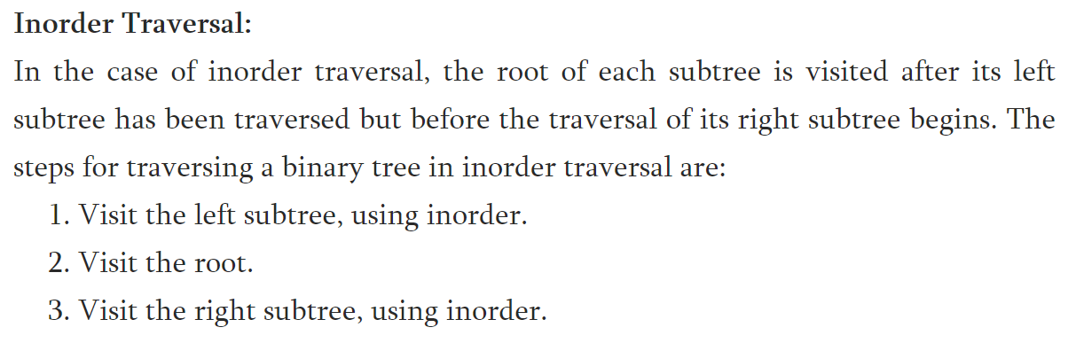
BINARY TREE TRAVERSALS
In-Order Traversal (Leftchild - Root - Rightchild )

Slide 65
IN ORDER TRAVERSAL
A
B
C
BAC

Slide 66
IN ORDER TRAVERSAL
a
1. Visit Left Subtree
12. Visit Right Subtree
b
11. Traverse Back.
Print the value: a
c
2. Visit Left Subtree
7. Visit Right Subtree.
13. Visit Left Subtree
18. Visit Right Subtree.
6. Traverse Back.
Print the value: b
17. Traverse Back.
Print the value: c
d
f
e
g
3. Left Subtree is NULL
4. Print the Value: d
5. Right Subtree is NULL
8. Left Subtree is NULL
9. Print the Value: e
10. Right Subtree is NULL
14. Left Subtree is NULL
15. Print the Value: f
16. Right Subtree is NULL
19. Left Subtree is NULL
20. Print the Value: g
21. Right Subtree is NULL
d
b
e
a
f
c
g

Slide 67
BINARY TREE TRAVERSALS
In-Order Traversal (Leftchild - Root - Rightchild )
In-Order Traversal for above example of binary tree is :
I - D - J - B - F - A - G - K - C - H

Slide 68
BINARY TREE TRAVERSALS
In-Order Traversal (Leftchild - Root - Rightchild )
+
*
E
*
D
/
C
A / B * C * D + E
A
B

Slide 69
BINARY TREE TRAVERSAL USING RECURSIVE APPROACH
INORDER USING RECURSIVE:
Inorder (ROOT)
Temp = ROOT
If Temp = = NULL
Return
End If
If Left(Temp) != NULL
Inorder (Left(Temp))
End If
Print (Temp)
If Right(Temp) != NULL
Inorder(Right(Temp))
End If
End Inorder
P
Q
R
S
T
TU
S -> Q -> T -> P -> U -> R

Slide 70
Inorder(P)
Temp = P
P != Null
If Left (P) != Null // Left(P) = Q
Inorder (Q)
End if
Print Temp // P
If Right(P)!= Null //Right(P) = R
Inorder(R)
End if
End Inorder(P)
Inorder(Q)
Temp = Q
Q != Null
If Left (Q) != Null // Left(Q) = S
Inorder (S)
End if
Print Temp // Q
If Right(P)!= Null //Right(Q) = T
Inorder(T)
End if
End Inorder(Q)
Inorder(S)
Temp = S
S != Null
If Left (S) != Null // Left(S) = NULL
Inorder () // Not Called
End if
Print Temp // S
If Right(S)!= Null //Right(S) = NULL
Inorder() // Not Called
End if
End Inorder(S)
1
2
3
P
Q
R
S
T
TU
S -> Q -> T -> P -> U -> R
Inorder(T)
Temp = T
T != Null
If Left (T) != Null // Left(T) = NULL
Inorder () // Not Called
End if
Print Temp // T
If Right(T)!= Null //Right(T) = NULL
Inorder() // Not Called
End if
End Inorder(T)
Inorder(R)
Temp = R
R != Null
If Left (R) != Null // Left(R) = U
Inorder (U)
End if
Print Temp // R
If Right(R)!= Null //Right(R) = NULL
Inorder() // Not Called
End if
End Inorder(R)
Inorder(U)
Temp = U
U != Null
If Left (U) != Null // Left(U) = NULL
Inorder () // Not Called
End if
Print Temp // U
If Right(U)!= Null //Right(U) = NULL
Inorder() // Not Called
End if
End Inorder(U)
4
5
6

Slide 71
ROOT = P
Step 1: Inorder (ROOT) // Inorder (P)
Step 2: Temp = ROOT // Temp = P
Step 3,4,5: Fails
Step 6: Left(Temp)=NULL
// Left(Temp) = Q
Step 7: Inorder(Q)
Step 1: Inorder(ROOT) // Assume Q
Step 2: Temp = Q
Step 6: Left (Q) = NULL
Step 7: Left(Temp) = NULL
// Left(Temp) = S
Step 1: Inorder (ROOT) // Assume S
Step 2: Temp = S
Step 3: Fails
Step 9: Print(Temp)
OUTPUT : S
ROOT = Q
Step 10: Right(Temp) = Null
// Right(Temp) = T
Step 11: Inorder(Right (Temp))
// Inorder(T)
Step 1: Inorder(T)
Step 2: Temp = ROOT // Temp = T
Step 3: Fails
Step 9: Print(Temp)
OUTPUT: S Q T
ROOT = Q
Step 1: Inorder(ROOT) // Assume Q
Step 2: Temp = ROOT // Temp = Q
Step 3,6: Fails, Already Visited
Step 9: Print(Temp)
OUTPUT: S Q
1
P
2
INORDER USING RECURSIVE:
Inorder (ROOT)
Step 2: Temp = ROOT
Step 3: If Temp == NULL
Step 4: Return
Step 5: End If
Step 6: If Left(Temp) != NULL
Step 7: Inorder (Left(Temp))
Step 8: End If
Step 9: Print (Temp)
Step 10 :If Right(Temp) != NULL
Step 11: Inorder(Right(Temp))
Step 12: End If
Step 13: End Inorder
Q
R
P
3
2
Q
R
S
T
U
3
P
S
T
U
Q
R
1
S
T
U
ROOT = P
Step 10: Right (Temp) = NULL
// Right (Temp) = R
Step 11: Inorder( R)
Step 1: Inorder (ROOT) // Assume R
Step 2: Temp = ROOT
Step 3: Fails
Step 6: Left(Temp) = NULL // U
Step 7: Inorder(U)
Step 1: Inorder(ROOT) // Assume U
Step 2: Temp = U
Step 3: fails
Step 9: Print (Temp)
OUTPUT: S Q T P U
ROOT = R
Step 1: Inorder(ROOT) // Inorder(R)
Step 2: Temp = ROOT // Temp = R
Step 3: Fails
Step 9: Print( Temp)
OUTPUT: S Q T P U R
Step 13: End
ROOT = P
Step 1: Inorder(P)
Step 2: Temp = ROOT // Temp = P
Step 3: Fails
Step 6: Already Visited
Step 9: Print (Temp)
OUTPUT: S Q T P
6
4
5
6
P
P
5
P
Q
R
Q
R
Q
R
4
S
T
U
S
T
U
S
T
U

Slide 72
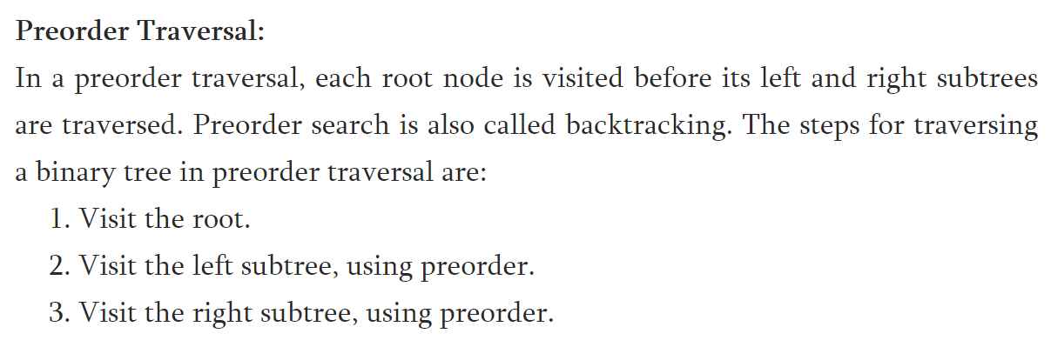
BINARY TREE TRAVERSALS
Pre-Order Traversal (Root - Leftchild - Rightchild)

Slide 73
PRE ORDER TRAVERSAL
A
B
C
ABC

Slide 74
PRE ORDER TRAVERSAL
a
1. Print the Value: a
2. Visit Left Sub Tree
12. Visit Right Sub Tree
b
13. Print the Value: c
14. Visit Left Sub Tree
c
3. Print the Value: b
4. Visit Left Sub Tree
15. Visit Right Sub Tree
8. Visit Right Sub Tree
d
e
f
g
5. Print the Value: d
6. Left Sub Tree is NULL
7. Right Sub Tree is NULL
9. Print the Value: e
10. Left Sub Tree is NULL
11. Right Sub Tree is NULL
15. Print the Value: f
16. Left Sub Tree is NULL
17. Right Sub Tree is NULL
18. Print the Value: g
19. Left Sub Tree is NULL
20. Right Sub Tree is NULL
a
b
d
e
c
f
g

Slide 75
BINARY TREE TRAVERSALS
Pre-Order Traversal (Root - Leftchild - Rightchild)
+
*
E
*
D
/
C
+ * * / A B C D E
A
B

Slide 76
BINARY TREE TRAVERSALS
Pre-Order Traversal (Root – Leftchild- Rightchild )
Pre-Order Traversal for above example of binary tree is :
A - B - D - I - J - F - C - G - K - H

Slide 77
BINARY TREE TRAVERSALS
Pre-Order Traversal (Root - Leftchild - Rightchild )
PREORDER USING RECURSIVE:
Preorder (ROOT)
Temp = ROOT
If Temp = = NULL
Return
End If
Print (Temp)
If Left(Temp) != NULL
Preorder (Left(Temp))
End If
If Right(Temp) != NULL
Preorder(Right(Temp))
End If
End Preorder
P
Q
R
S
T
TU
P -> Q -> S -> T -> R -> U

Slide 78
Preorder(P)
Temp = P
P != Null
Print Temp // P
If Left (P) != Null // Left(P) = Q
Preorder (Q)
End if
If Right(P)!= Null //Right(P) = R
Preorder(R)
End if
End Preorder(P)
Preorder(Q)
Temp = Q
Q != Null
Print Temp // Q
If Left (Q) != Null // Left(Q) = S
Preorder (S)
End if
If Right(P)!= Null //Right(Q) = T
Preorder(T)
End if
End Preorder(Q)
Preorder(S)
Temp = S
S != Null
Print Temp // S
If Left (S) != Null // Left(S) = NULL
Preorder () // Not Called
End if
If Right(S)!= Null //Right(S) = NULL
Preorder() // Not Called
End if
End Preorder(S)
1
2
3
P
Q
R
S
T
TU
P -> Q -> S -> T -> R -> U
Preorder(T)
Temp = T
T != Null
Print Temp // T
If Left (T) != Null // Left(T) = NULL
Preorder () // Not Called
End if
If Right(T)!= Null //Right(T) = NULL
Preorder() // Not Called
End if
End Preorder(T)
Preorder(R)
Temp = R
R != Null
Print Temp // R
If Left (R) != Null // Left(R) = U
Preorder (U)
End if
If Right(R)!= Null //Right(R) = NULL
Preorder() // Not Called
End if
End Preorder(R)
Preorder(U)
Temp = U
U != Null
Print Temp // U
If Left (U) != Null // Left(U) = NULL
Preorder () // Not Called
End if
If Right(U)!= Null //Right(U) = NULL
Preorder() // Not Called
End if
End Preorder(U)
4
5
6

Slide 79
Temp = P
Step 7: Left(Temp) = NULL
// Left(Temp) = Q
Step 8: Preorder(Left(Temp))
// Preorder (Q)
Step 1: Preorder(ROOT) // Assume Q
Step 2: Temp = ROOT // Temp = Q
Step 3: Fails
Step 6: Print (Temp)
OUTPUT : P Q
Temp = Q
Step 7: Left(Temp) = NULL
// Left(Temp) = S
Step 8: Preorder (Left(Temp))
// Preorder (S)
Step 1: Preorder(ROOT) //Assume S
Step 2: Temp = ROOT // Temp = S
Step 3: Fails
Step 6: Print (Temp)
OUTPUT : P Q S
3
P
Q
R
PREORDER USING RECURSIVE:
Step1: Preorder (ROOT)
Step2: Temp = ROOT
Step3: If Temp = = NULL
step4: Return
Step5: End If
Step 6: Print (Temp)
Step7: If Left(Temp) != NULL
Step8: Preorder (Left(Temp))
Step9: End If
Step10: If Right(Temp) != NULL
Step11: Preorder(Right(Temp))
Step12: End If
Step13: End Preorder
S
T
U
2
3
ROOT = P
Step 1: Function call Preorder(ROOT) // Preorder (P)
Step 2: Temp = Root // Temp = P
Step 3: Fails
Step 6: Print (Temp)
OUTPUT : P
P
2
P
Temp = R
Step 7: Left(Temp) = NULL
// Left(Temp) = U
Step 8: Preorder (Left(Temp))
// Preorder(U)
Step 1: Preorder(ROOT) // Assume U
Step 2: Temp = ROOT // Temp = U
Step 3: Fails
Step 6: Print (Temp)
OUTPUT: P Q S T R U
Step 13: End
6
1
Q
R
Q
R
P
S
T
U
S
T
U
1
Q
R
S
T
U
ROOT = P , Temp = P
Step 10: Right (Temp) = NULL
// Right(Temp) = R
Step 11: Preorder (Right (Temp))
// Preorder (R)
Step 1: Preorder(ROOT) // Preorder (R )
Step 2: Temp = ROOT // Temp = R
Step 3: Fails
Step 6: Print (Temp)
OUTPUT: P Q S T R
6
Temp = Q
Step 10: Right(Temp) = NULL
// Right(Temp) = T
Step 11: Preorder(Right(Temp))
// Preorder(T)
Step 1: Preorder(ROOT) // Assume T
Step 2: Temp = ROOT // Temp = T
Step 3: Fails
Step 6: Print( Temp)
OUTPUT: P Q S T
P
Q
R
P
S
T
U
4
Q
R
5
S
U
4
T
5

Slide 80
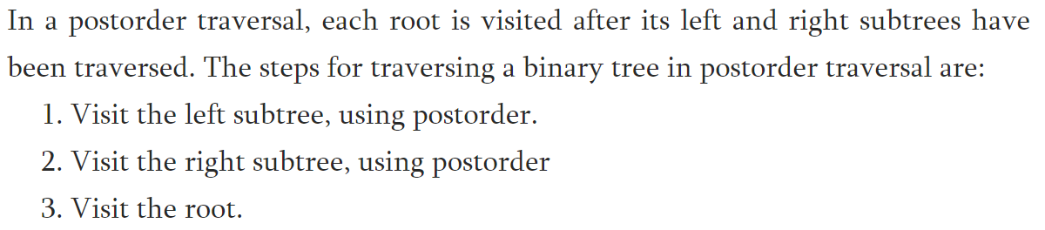
BINARY TREE TRAVERSALS
Post-Order Traversal (Leftchild – Rightchild - Root)

Slide 81
POST ORDER TRAVERSAL
A
B
C
BCA

Slide 82
POST ORDER TRAVERSAL
a
1. Visit Left Sub Tree
20. Print the Value: a
11. Visit Right Sub Tree
b
c
15. Visit Right Sub Tree
2. Visit Left Sub Tree
10. Print the Value: b
12. Visit Left Sub Tree
19. Print the Value: c
6. Visit Right Sub Tree
d
e
f
g
3. Left Sub Tree is NULL
4 Right Sub Tree is NULL
5. Print the Value: d
13. Left Sub Tree is NULL
14. Right Sub Tree is NULL
15. Print the Value: f
7. Left Sub Tree is NULL
8. Right Sub Tree is NULL
9. Print the Value: e
16. Left Sub Tree is NULL
17. Right Sub Tree is NULL
18. Print the Value: g
d
e
d
f
g
c
a

Slide 83
BINARY TREE TRAVERSALS
Post-Order Traversal (Leftchild – Rightchild- Root)
+
*
E
*
D
/
C
A B / C * D * E +
A
B

Slide 84
BINARY TREE TRAVERSALS
Post-Order Traversal ( Leftchild - Rightchild - Root )
Post-Order Traversal for above example of binary tree is :
I - J - D - F - B - K - G - H - C - A

Slide 85
BINARY TREE TRAVERSALS
Post-Order Traversal ( Leftchild - Rightchild - Root )
POSTORDER USING RECURSIVE:
POSTORDER(ROOT)
Temp = ROOT
If temp = NULL
Return
End if
If left(temp) ≠ NULL
POSTORDER(left(temp))
End if
If right(temp) ≠ NULL
POSTORDER(right(temp))
End if
Print (temp)
End POSTORDER
P
Q
R
S
T
TU
S -> T -> Q -> U -> R -> P

Slide 86
Postorder(P)
Temp = P
P != Null
If Left (P) != Null // Left(P) = Q
Postorder (Q)
End if
If Right(P)!= Null //Right(P) = R
Postorder(R)
End if
Print Temp // P
End Postorder(P)
Postorder(Q)
Temp = Q
Q != Null
If Left (Q) != Null // Left(Q) = S
Postorder(S)
End if
If Right(P)!= Null //Right(Q) = T
Postorder(T)
End if
Print Temp // Q
End Postorder(Q)
Postorder(S)
Temp = S
S != Null
If Left (S) != Null // Left(S) = NULL
Postorder() // Not Called
End if
If Right(S)!= Null //Right(S) = NULL
Postorder() // Not Called
End if
Print Temp // S
End Postorder(S)
1
2
3
P
Q
R
S
T
TU
S -> T -> Q -> U -> R -> P
Postorder(T)
Temp = T
T != Null
If Left (T) != Null // Left(T) = NULL
Postorder () // Not Called
End if
If Right(T)!= Null //Right(T) = NULL
Postorder() // Not Called
End if
Print Temp // T
End Postorder(T)
Postorder(R)
Temp = R
R != Null
If Left (R) != Null // Left(R) = U
Postorder (U)
End if
If Right(R)!= Null //Right(R) = NULL
Postorder() // Not Called
End if
Print Temp // R
End Postorder(R)
Postorder(U)
Temp = U
U != Null
If Left (U) != Null // Left(U) = NULL
Postorder () // Not Called
End if
If Right(U)!= Null //Right(U) = NULL
Postorder() // Not Called
End if
Print Temp // U
End Postorder(U)
4
5
6

Slide 87
ROOT = P
Step 1: Temp = ROOT // Temp = P
Step 2: Fails
Step 5: Left(Temp) = Q
Step 6: POSTORDER( Q)
Step 1: Temp = ROOT // Temp = Q
Step 2: Fails
Step 5: left(Q) = S
Step 6: POSTORDER(S)
Step 1: Temp = S
Step 2: Fails
Step 5: Fails
Step 8: Fails
Step 11: Print(Temp)
OUTPUT: S
3
1
ROOT = Q
Step 8: Right(Temp) = T
Step 9: POSTORDER (T)
Step 1: Temp = T
Step 2: Fails
Step 11: Print(Temp)
OUTPUT: S T
ROOT = Q
Step 1: Temp = Q
Step 2: Fails
Step 5: Already visited
Step 8: Already visited
Step 11:Print(Temp)
OUTPUT: S T Q
P
Q
R
P
2
3
S
T
U
Q
R
P
2
S
T
U
Q
R
ROOT = P
Step 1: Temp = P
Step 2: Fails
Step 5: Already visited
Step 8: Already visited
Step 11:Print(temp)
OUTPUT: S T Q U R P
Step 2: temp = Null
Step 4: End
Step 12:End
POSTORDER USING RECURSIVE:
POSTOREDER(ROOT)
Step 1: Temp = ROOT
Step 2: If temp = NULL
Step 3: Return
Step 4: End if
Step 5: If left(temp) ≠ NULL
Step 6: POSTORDER(left(temp))
Step 7: End if
Step 8: If right(temp) ≠ NULL
Step 9: POSTORDER(right(temp))
Step 10:End if
Step 11:Print (temp)
Step 12:End POSTORDER
1
ROOT = P
Step 1: Temp = Root
Step 2: Fails
Step 8: Right(Temp) = R
Step 9: POSTORDER (R)
Step 1: Temp = R
Step 2: Fails
Step11:Print(Temp)
OUTPUT: S T Q U R
S
T
U
ROOT = P
Step 1: Temp = P
Step 2: Fails
Step 5: Fails
Step 6: Right(Temp) = R
Step 7: POSTORDER (R)
Step 1: Temp = R
Step 2: Fails
Step 5:left(temp) = U
Step 6: POSTORDER(U)
Step 1: Temp = U
Step 2: Fails
Step 5: Fails
Step 6: Fails
Step 11: Print(Temp)
OUTPUT: S T Q U
4
5
P
6
Q
R
P
P
Q
R
S
T
U
6
4
5
Q
R
S
T
U
S
T
U

Slide 88
BINARY TREE TRAVERSAL
IN ORDER: LEFT CHILD -> ROOT NODE -> RIGHT CHILD
PRE ORDER: ROOT NODE -> LEFT CHILD -> RIGHT CHILD
POST ORDER: LEFT CHILD -> RIGHT CHILD -> ROOT NODE
Binary tree traversal can be implemented :
Recursive Approach
Iterative Approach
Recursive | Iterative
Execute the set of instructions repeatedly It is a method call where the method being called is the same as one making call (Function call itself) | Execute the set of instructions repeatedly Loop is repeated until the certain condition met

Slide 89
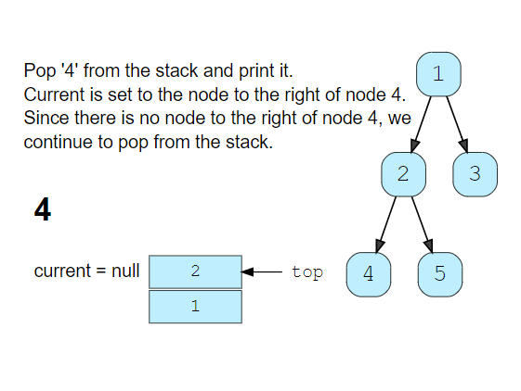
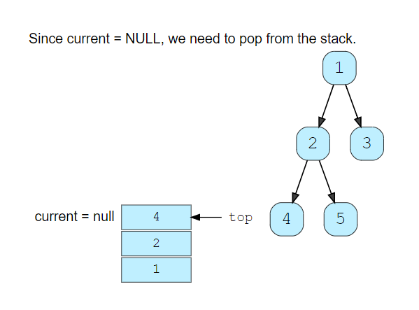
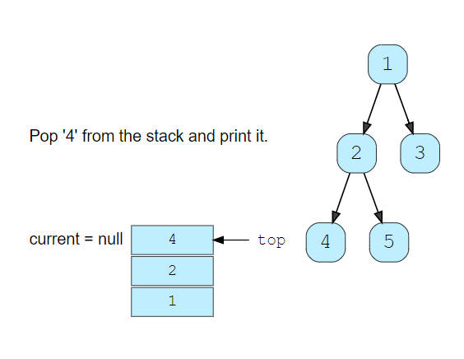
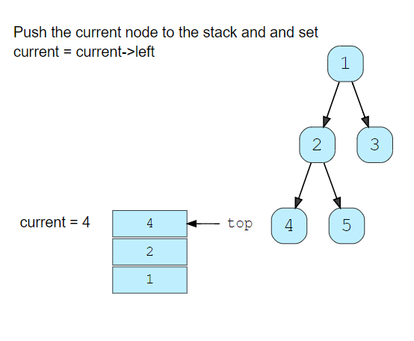
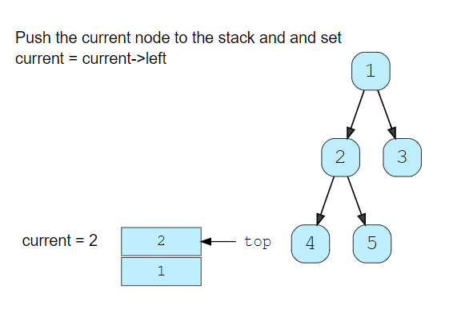
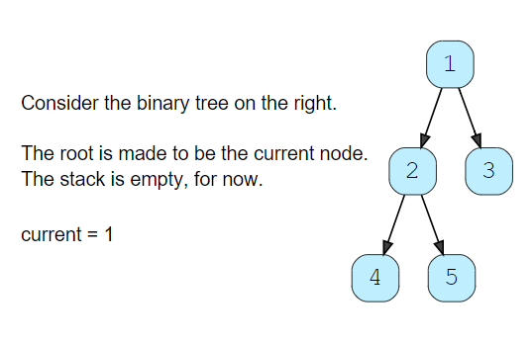
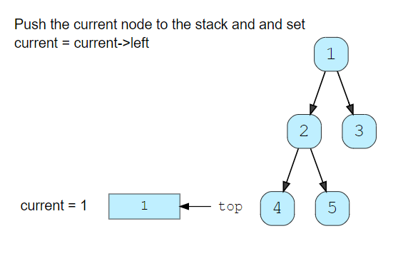
BINARY TREE TRAVERSALS
In-Order Traversal ( Leftchild – Root - Rightchild )

Slide 90
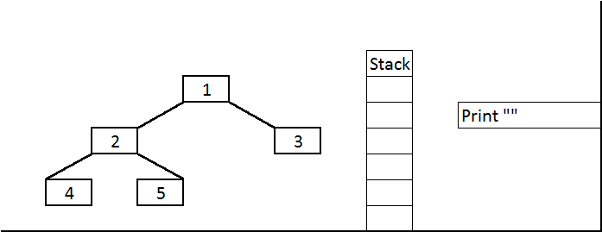
BINARY TREE TRAVERSALS
In-Order Traversal (Leftchild – Root - Rightchild)

Slide 91
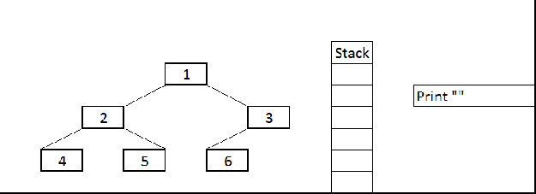
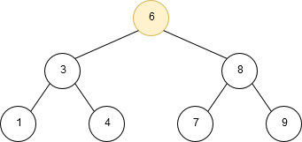
BINARY TREE TRAVERSALS
Pre-Order Traversal (Leftchild – Root - Rightchild)

Slide 92
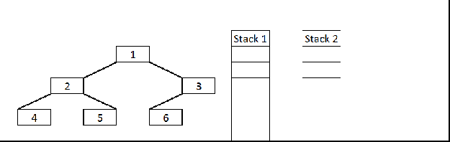
BINARY TREE TRAVERSALS
Post-Order Traversal (Leftchild – Root - Rightchild)
If you just observe here, postorder traversal is just reverse of preorder traversal (1 3 6 2 5 4 if we traverse the right node first and then left node.)
So idea is follow the same technique as preorder traversal and instead of printing it push it to the another Stack so that they will come out in reverse order (LIFO).
At the end just pop all the items from the second Stack and print it.

Slide 93
BINARY TREE TRAVERSALS
Traversing a tree
Before we dive into the binary search trees, the two general ways of traversing any tree:
depth-first search and breadth-first search.
Depth-first search
Depth-first traversal is a technique in which branches of a tree will be fully explored before taking steps back and traversing other branches/leaves.
The three most common traversal orders for depth-first search are:
Pre-order traversal: visit current node first, then children.
In-order traversal: visit left child first, then current node, then right child.
Post-order traversal: visit children first, then current node.
Breadth-first search
The other way of traversing a tree is breadth-first search, where the different layers of a tree will be traversed one-by-one. This means that the root layer (containing one node) will always be visited first, then all nodes in the next layer, etc.
In practice, this is usually done by putting nodes to visit in a queue. Using a queue guarantees certain nodes (those less deep in the tree) will be visited/processed first.

Slide 94
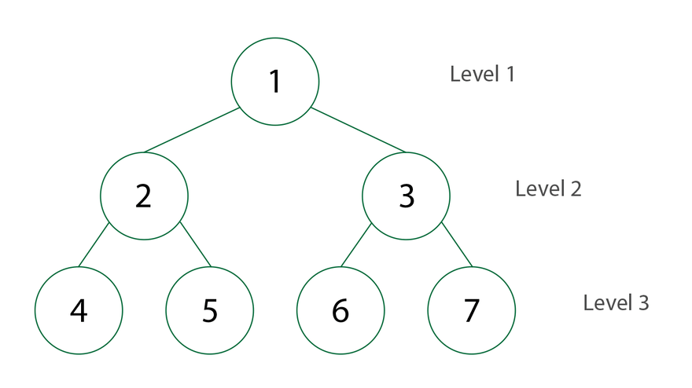
BINARY TREE TRAVERSALS
BREADTH FIRST SEARCH
Level Order Traversal
Visit the root first
Visit the roots left child
Visit the roots right child
Continue the traverse at each level
Employs Queue Data Structure

Slide 95
BINARY TREE TRAVERSALS
BREADTH FIRST SEARCH
queue
root
a
a
Print a
b | c
b
c
Print b
c | d | e
Print c
d | e | f | g
d
e
f
g
Print d
e | f | g
Print e
f | g
Print f
g
Print g

Slide 96
BINARY SEARCH TREES (BST)
A Binary Search Tree is a binary Tree.
It may be empty.
If it is not empty then it satisfies the following properties:
Every element has a key and no two elements have the same key
The keys (if any) in the left subtree are smaller than the key in the root.
The keys (if any) in the right subtree are greater than the key in the root.
The left and right subtrees are also binary search trees.

Slide 97
BINARY SEARCH TREES (BST)
20 10 25
50 75 25 35 15 65 85
50
20
10
25
25
75
15
35
65
85

Slide 98
BINARY SEARCH TREES (BST)
100 90 80 70 60
60 70 80 90 100
60
100
70
90
80
80
90
70
100
60

Slide 99
BINARY SEARCH TREES (BST)
92 93 90 91 88 89 87
92
90
93
88
91
87
89

Slide 100
Example
200
150
300
100
175
250
350
50
125
160
190
225
275
325
400

Slide 101
Identify:
500
20
10
15
50
750
Not a BST
150
225
850
725
Not a BST

Slide 102
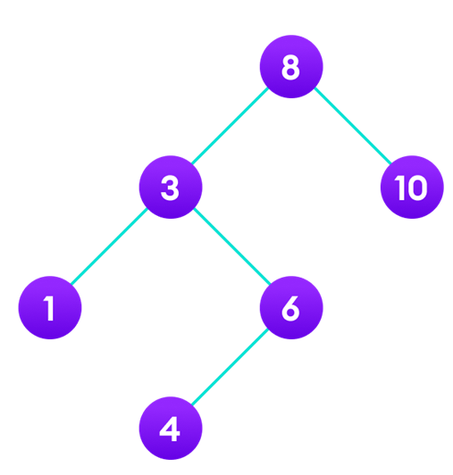
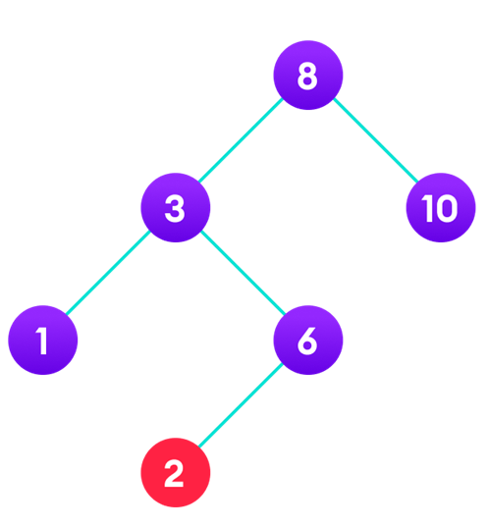


BINARY SEARCH TREE

Slide 103
ADT of BST
Search
Insert
Delete
Minimum
Maximum
Predecessor
Successor
Traverse
In Order
Pre Order
Post Order
Level Order

Slide 104




BINARY SEARCH TREE (BST) - SEARCH
Search (root, X)
temp=root; par=NULL; Loc=NULL
If root == NULL
return NULL;
else
while temp != NULL
if X == temp -> data
Loc =temp;
return Loc;
else if X < temp -> data
par = temp
temp = temp -> left
else
par = temp
temp = temp -> right
end if
end while
endif
SEARCH(4)
Search (root, X)
If Loc != NULL
Write “Element Found”
else
Write “Not Found”
endif
SEARCH ELEMENT 4 FOUND

Slide 105
Search Algorithm (Recursive)
bftSearch(x, k)
1. if x = NIL or k = key[x]
2. then return x
3. if k < key[x]
4. then return bftSearch(left[x], k)
5. else return bftSearch(right[x], k)

Slide 106
Search Algorithm (Iterative)
bftSearch(x, k)
1. while x ≠ NIL and k ≠ key[x]
2. do if k < key[x]
3. then x ← left[x]
4. else x ← right[x]
5. return x

Slide 107
Minimum & Maximum
The binary-search-tree property guarantees that:
The minimum is located at the left-most node.
The maximum is located at the right-most node.
bstMinimum(x) bstMaximum(x)
1. while left[x] ≠ NIL 1. while right[x] ≠ NIL
2. do x ← left[x] 2. do x ← right[x]
3. return x 3. return x

Slide 108
Successor
Successor of node x is the node y such that key[y] is the smallest key greater than key[x].
The successor of the largest key is NIL.
Search consists of two cases.
If node x has a non-empty right subtree, then x’s successor is the minimum in the right subtree of x.
If node x has an empty right subtree, then:
As long as we move to the left up the tree (move up through right children), we are visiting smaller keys.
x’s successor y is the node that x is the predecessor of (x is the maximum in y’s left subtree).
In other words, x’s successor y, is the lowest ancestor of x whose left child is also an ancestor of x.

Slide 109


Slide 110


Slide 111


Slide 112
Successor
Successor of node x is the node y such that key[y] is the smallest key greater than key[x].
The successor of the largest key is NIL.
Search conists of two cases.
If node x has a non-empty right subtree, then x’s successor is the minimum in the right subtree of x.
If node x has an empty right subtree, then:
As long as we move to the left up the tree (move up through right children), we are visiting smaller keys.
x’s successor y is the node that x is the predecessor of (x is the maximum in y’s left subtree).
In other words, x’s successor y, is the lowest ancestor of x whose left child is also an ancestor of x.

Slide 113


Slide 114
Pseudocode
bstSuccessor(x)
1. if right[x] ≠ NIL
2. then return bstMinimum(right[x])
3. y ← p[x]
4. while y ≠ NIL and x = right[y]
5. do x ← y
6. y ← p[y]
7. return y

Slide 115
Predecessor
Predecessor of node x is the node y such that key[y] is the largest key smaller than key[x].
The Predecessor of the smallest key is NIL.
Search consists of two cases.
If node x has a non-empty left subtree, then x’s Predecessor is the maximum in the right subtree of x.
If node x has an empty left subtree, then:
As long as we move to the right down the tree (move down through left children), we are visiting larger keys.
x’s Predecessor y is the node that x is the predecessor of (x is the minimum in y’s right subtree).
In other words, x’s Predecessor y, is the greatest descendant of x whose right child is also an descendant of x.

Slide 116
Pseudocode
bstPredecessor(x)
1. if left[x] ≠ NIL
2. then return bstMaximum(left[x])
3. y ← p[x]
4. while y ≠ NIL and x = left[y]
5. do x ← y
6. y ← p[y]
7. return y

Slide 117

BINARY SEARCH TREE INSERTION
Insert (10)
Insert (5)

Slide 118

BINARY SEARCH TREE (BST) - INSERTION
INSERT( ROOT, X )
temp = ROOT, Par = NULL
while temp ≠ NULL
if X == temp → Data
write “Element exists!”
return
end if
else if X < temp → Data
Par = temp
temp = temp → Left
else
Par = temp
temp = temp → Right
end if
end while
INSERT (Root, X)
N→Data=X; N→Left=NULL; N→Right=NULL;
if Par = NULL
ROOT = N
else if X < Par→data
Par→Left = N
else
Par→Right = N
end if
end INSERT

Slide 119


BINARY SEARCH TREE (BST) - DELETION
Case 0 – Leaf Node
if X has no children
then remove X

Slide 120
BST-Deletion
Case 0 – Leaf Node
if x has no children
then remove x
a
a
b
c
b
c
d
e
f
g
X=
e
f
g

Slide 121


BINARY SEARCH TREE (BST) - DELETION
Case 1 – Node with one Child
if X has one child
then Make Par[X] point to child

Slide 122


BINARY SEARCH TREE (BST) - DELETION
Case 1 – Node with one Child
if X has one child
then Make Par[X] point to child
X =

Slide 123


BINARY SEARCH TREE (BST) - DELETION
Case 2 – Node with Two Child
if X has two children (subtrees)
then
Swap X with its successor
Perform case 0 or case 1 to Delete it
X =
Replace with Leftmost node of the right subtree or rightmost node of the left subtree.

Slide 124




BINARY SEARCH TREE (BST) - DELETION
2
1
3
4

Slide 125



BINARY SEARCH TREE (BST) - DELETION
5
6

Slide 126
BINARY SEARCH TREE
(BST) - DELETION
CASEA( Loc, par )
Temp = Loc→Right
Save = Loc
while Temp→Left ≠ NULL
Save = Temp
Temp = Temp→Left
end while
Suc = Temp
Parsuc = Save
CASEB( suc, parsuc)
if Par ≠ NULL
if Loc = Par→Left
Par→Left = Suc
else
Par→Right = Suc
end if
else
ROOT = Suc
end if
Suc→Left = Loc→Left
Suc→Right = Loc→Right
end CASEA
CASEB(Loc, Par )
Temp = Loc
if Temp → Left = NULL and
Temp→Right= NULL
Child = NULL
else
if Temp→Left ≠ NULL
Child = Temp→Left
else
Child = Temp→Right
end if
end if
if Par ≠ NULL
if Temp = Temp→Left
Par→Left = Child
else
Par→Right = Child
end if
else
ROOT = Child
end if
end CASEB
DELETE( ROOT, k )
SEARCH( ROOT, k )
if Loc = NULL
Write “Element not found”
return
end if
if Loc→Right ≠ NULL and
Loc→Left ≠ NULL
CASEA(Loc, par)
else
CASEB(Loc, par)
end if
end DELETE

Slide 127
BINARY SEARCH TREE (BST) - DELETION
K
CASE A
DELETE( ROOT, k )
SEARCH( ROOT, k )
//Returns Par and Loc
if Loc = NULL
Write “Element not found”
return
end if
if Loc→Right ≠ NULL and
Loc→Left ≠ NULL
CASEA(Loc, par)
else
CASEB(Loc, par)
end if
end DELETE
G
M
X =
D
H
L
N
K
K
G
M
X =
G
M
X =
CASE B.a
L
N
D
L
N
CASE B.b

Slide 128
BST-DELETION (CASEB)
CASEB (Loc, Par )
Temp = Loc
if Temp → Left = NULL and
Temp→Right= NULL
Child = NULL
else
if Temp→Left ≠ NULL
Child = Temp→Left
else
Child = Temp→Right
end if
end if
if Par ≠ NULL
if Temp = Temp→Left
Par→Left = Child
else
Par→Right = Child
end if
else
ROOT = Child
end if
end CASEB
K
K
Loc / Temp
G
M
M
X =
Child = NULL
L
L
N
N
K
K
X =
G
M
D
M
D
L
N
L
N
Child

Slide 129
BST-DELETION (CASEA)
CASEA( Loc, par )
Temp = Loc→Right
Save = Loc
while Temp→Left ≠ NULL
Save = Temp
Temp = Temp→Left
end while
Suc = Temp
Parsuc = Save
CASEB( suc, parsuc)
if Par ≠ NULL
if Loc = Par→Left
Par→Left = Suc
else
Par→Right = Suc
end if
else
ROOT = Suc
end if
Suc→Left = Loc→Left
Suc→Right = Loc→Right
end CASEA
Par
ParSuc
K
K
Loc / Save
H
M
G
Suc
M
X =
Temp
L
N
D
H
L
N
D
G
Suc
D
NULL
H
Traverse to the leftmost child of the Right Subtree and mark it as Suc and its parent and Parsuc respectively.

Slide 130
BST-DELETION (CASEA)
Par
Par
Save
K
Loc
K
K
Suc
G
M
G
X =
G
O
Save
ParSuc
D
D
H
L
P
D
H
H
L
P
Temp
O
R
P
Suc
N
R
N
Suc
N
R
O

Slide 131
Conversions
Construct binary tree from traversals
In order: 2,1, 3
Post order: 2, 3, 1
In order: 4, 8, 2, 5, 1, 6, 3, 7
Post order: 8, 4, 5, 2, 6, 7, 3, 1
3) In order: 9, 3, 15, 20, 7
Post order: 9, 15, 7, 20, 3
4) In order: 2, 5, 6, 10, 12, 14, 15
Post order: 2, 6, 5, 12, 15, 14, 10

Slide 132
BINARY SEARCH TREE
Complexity Analysis
Operation | Average complexity | Worst case complexity
Searching | O(log n) | O(n)
Insertion | O(log n) | O(n)
Deletion | O(log n) | O(n)
Space complexity | O(n) | O(n)

